Slide 1

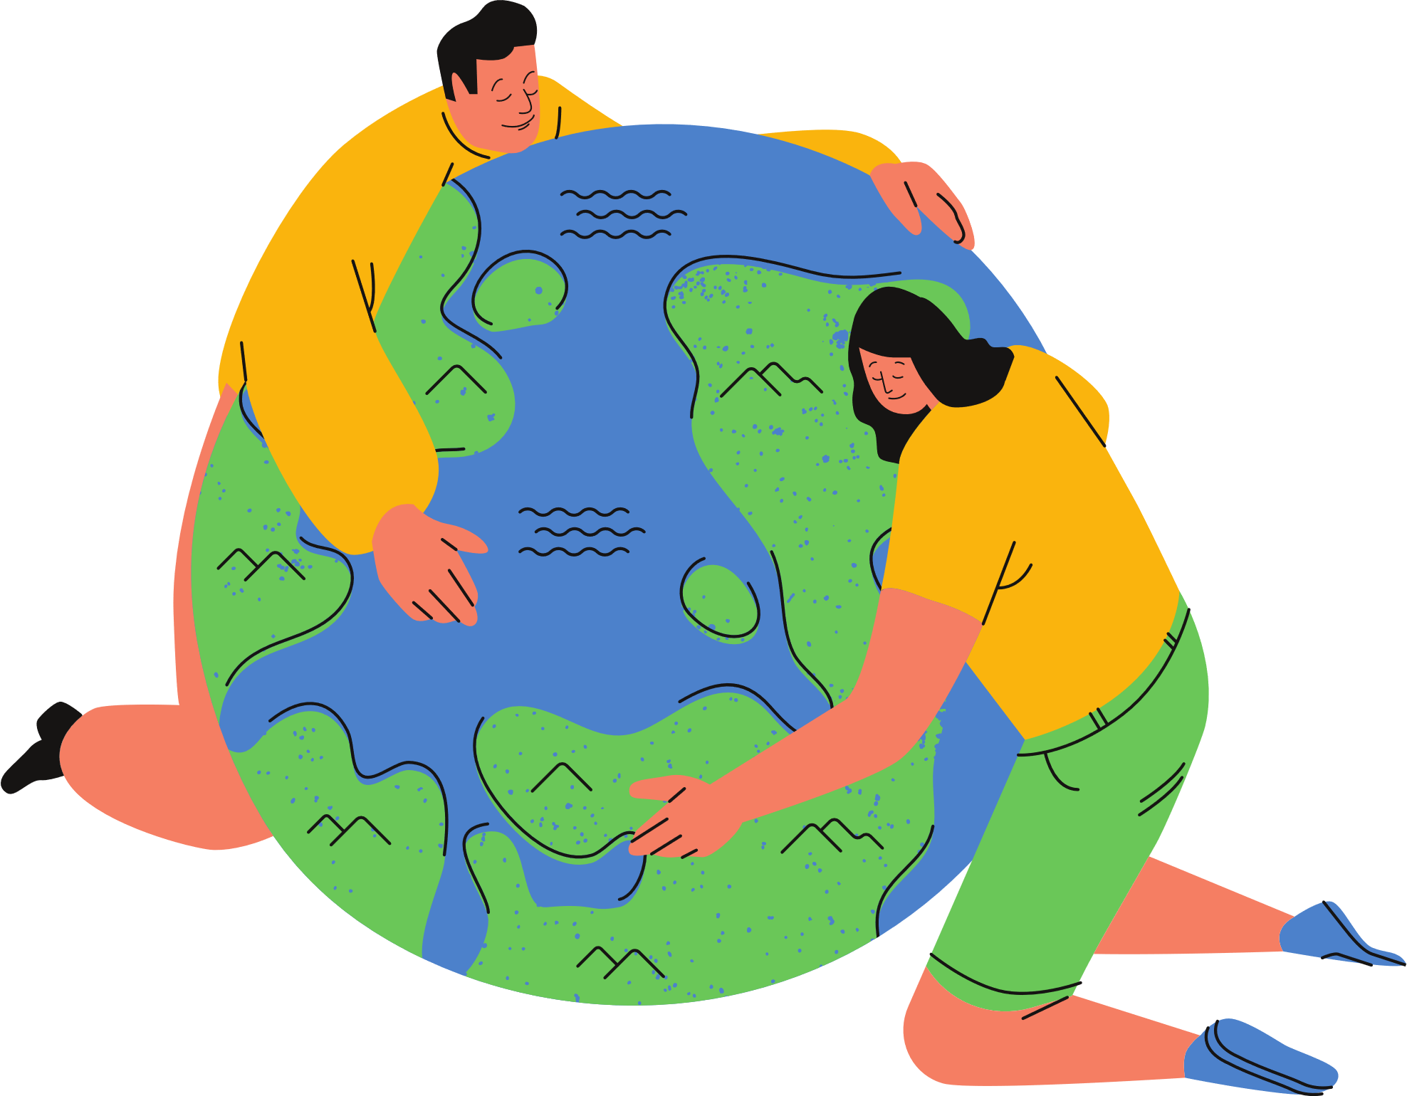
EXPLORING
EARTH’S
SYSTEMS
By learning about these systems and how they interact, you can better understand the complex and fascinating world we live in.

Slide 2

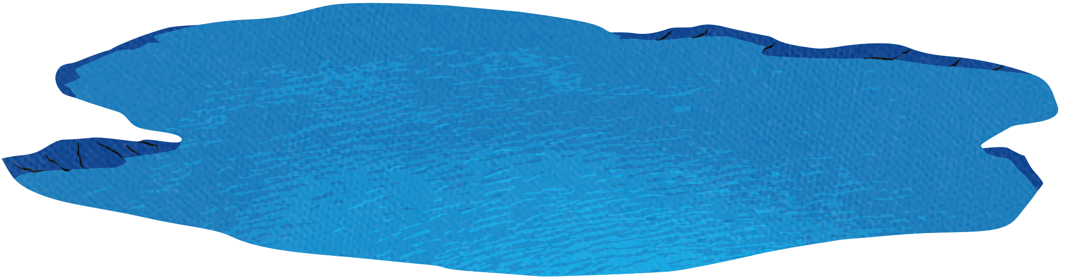
WHAT ARE EARTH'S SYSTEMS?
A connection related to Earth's systems involves the interaction between different components of the planet's environment. These systems are interdependent, and changes in one system can influence others.
Earth’s systems are the interconnected components that make up our planet, each playing a vital role in maintaining balance and supporting life. These systems are:
Atmosphere
Hydrosphere
Geosphere
Biosphere

Slide 3

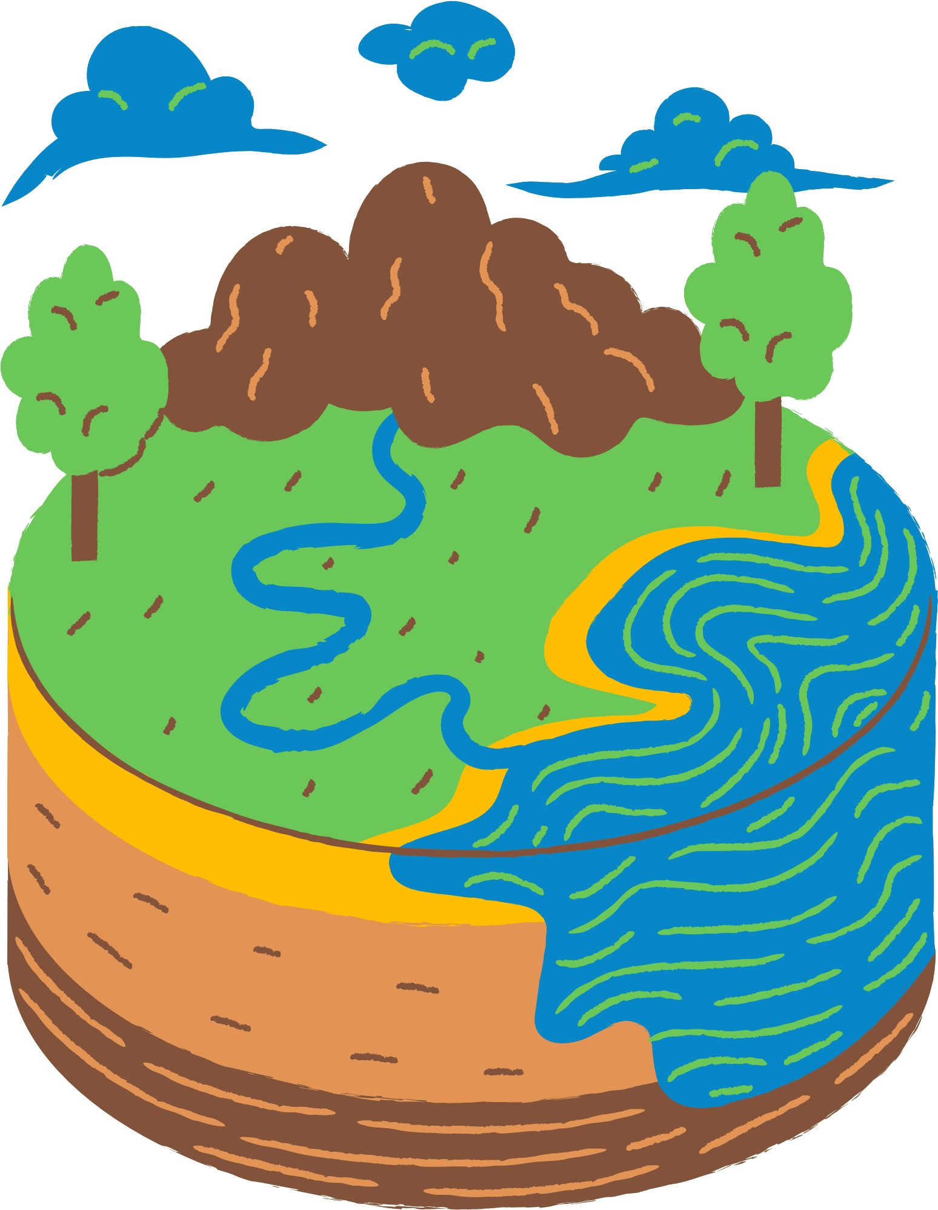
GEOSPHERE
The geosphere refers to the solid, rocky part of Earth, including its internal structure and surface features.
The geosphere includes mountains, volcanoes, valleys, and ocean floors, as well as deeper structures like tectonic plates.
These elements interact with other Earth systems, such as the atmosphere and hydrosphere, to shape landforms, cause earthquakes, and influence natural processes like erosion and soil formation.
ATMOSPHERE
The atmosphere is the layer of gases that surrounds Earth, protecting and sustaining life by regulating temperature, providing oxygen, and filtering harmful solar radiation.
It is composed primarily of nitrogen (78%) and oxygen (21%), with small amounts of other gases like carbon dioxide, water vapor, and ozone.

Slide 4
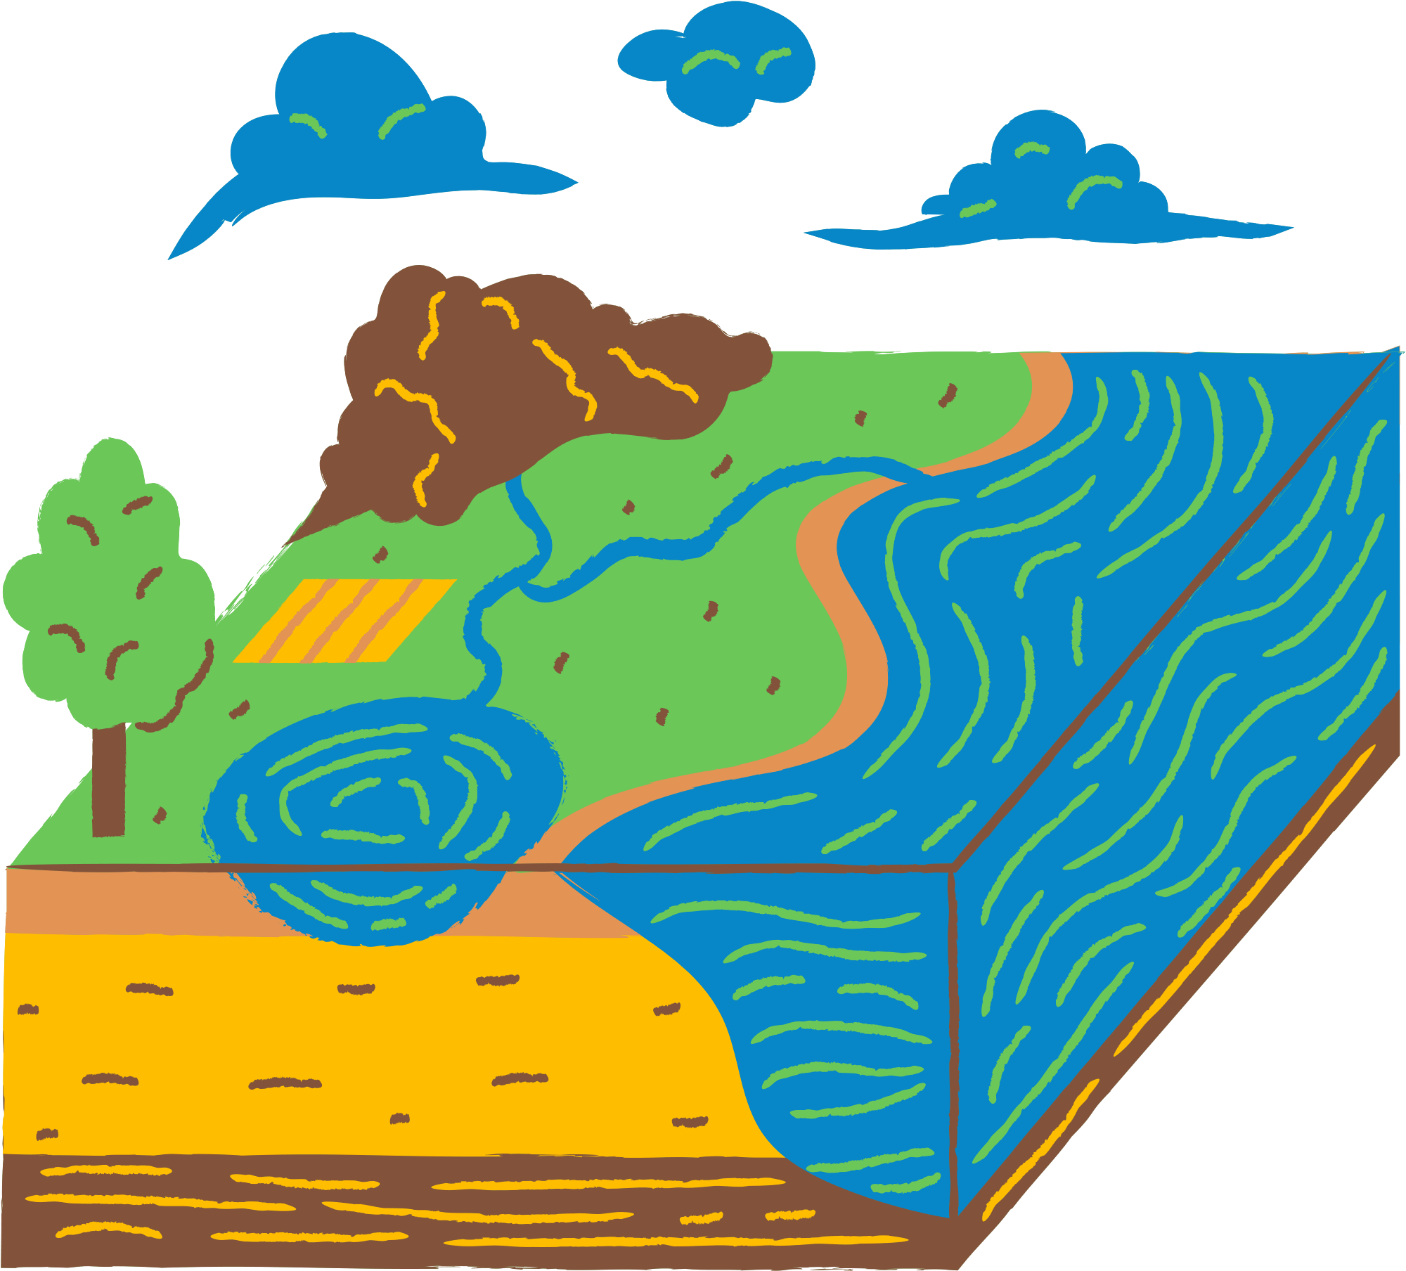

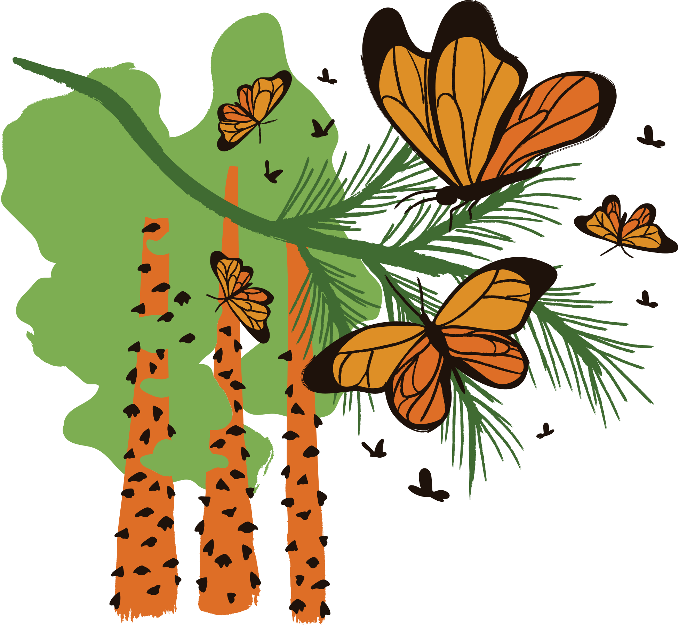
BIOSPHERE
The biosphere is the part of Earth where life exists, encompassing all living organisms, including plants, animals, fungi, bacteria, and humans.
It includes ecosystems found in various environments, from deep ocean trenches to high mountain peaks, and interacts closely with other Earth systems.
HYDROSPHERE
The hydrosphere encompasses all the water on Earth, including oceans, rivers, lakes, glaciers, groundwater, and even water vapor in the atmosphere.
It covers about 71% of Earth's surface and plays a critical role in regulating climate, supporting ecosystems, and shaping landforms.
The hydrosphere is essential for the water cycle, which moves water between the atmosphere, geosphere, and biosphere through processes like evaporation, precipitation, and runoff.

Slide 5

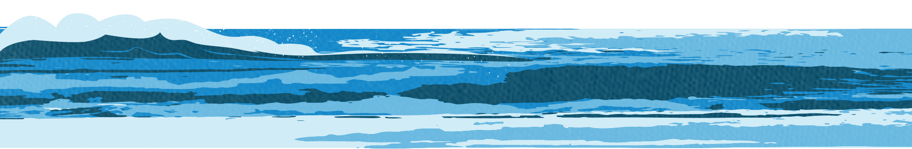
Air Quality:
As air quality declines due to acid rain, plants struggle to grow, reducing their ability to filter pollutants, which in turn worsens air quality.
Waterbodies:
Poor water quality affects plants and animals living near water sources, and toxic runoff from the waterbodies may enter the soil, impacting plant growth.
IMPACTS ON ACID RAIN

Slide 6
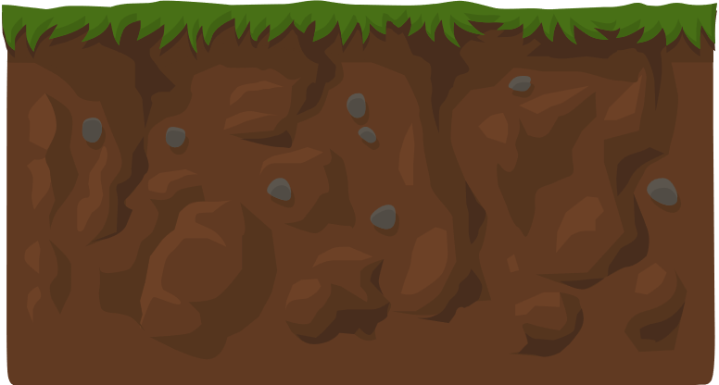
Soil:
Nutrient-poor soil reduces plant productivity, which limits the plants' ability to absorb CO₂, contributing to increased levels of atmospheric pollution and worsening air quality.
Plant Life:
Plants’ reduced health from soil degradation leads to less robust ecosystems, lowering biodiversity and further harming water and air quality as there are fewer plants to filter pollutants and maintain ecological balance.
IMPACTS ON ACID RAIN

Slide 7

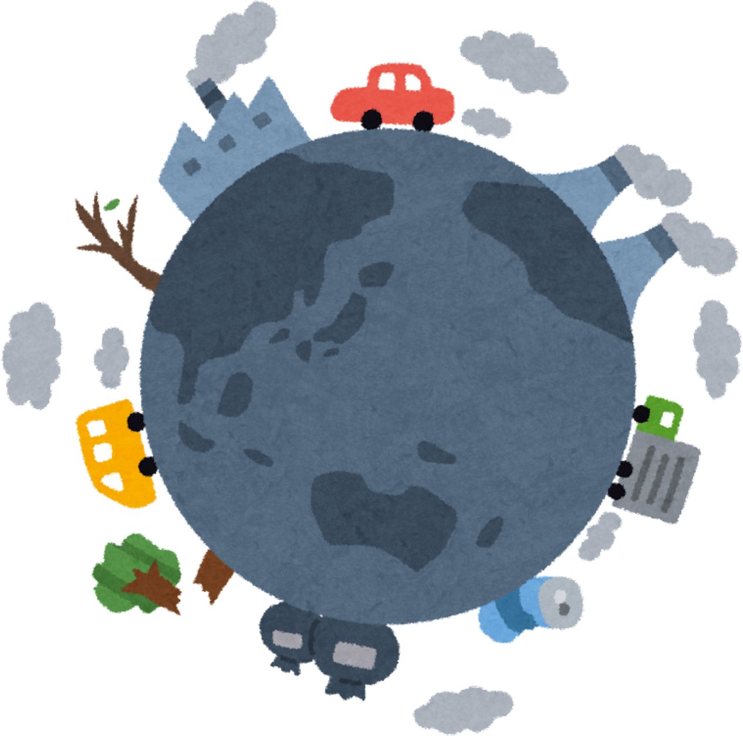
IMPACTS ON POLLINATOR DECLINE
Crop Yield:
A decline in pollinator populations leads to lower pollination rates for many fruit and vegetable crops. This results in reduced crop yields, affecting food production and agricultural income.
Biodiversity:
Pollinators are vital for the reproduction of many plants, including wildflowers and crops. Their decline can lead to decreased plant diversity, disrupting local ecosystems and food webs.
Deforestation:
To compensate for lower yields, farmers may convert more land into agricultural fields, leading to deforestation. As forests are cleared, the flowers and plants that provide food and nesting sites for pollinators are lost.

